Slide 1

Chapter 11: Network Programming
CSCI3240: Lecture 14 and 15
Dr. Arpan Man Sainju
Middle Tennessee State University

Slide 2
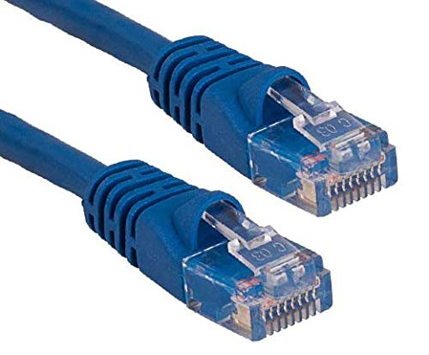
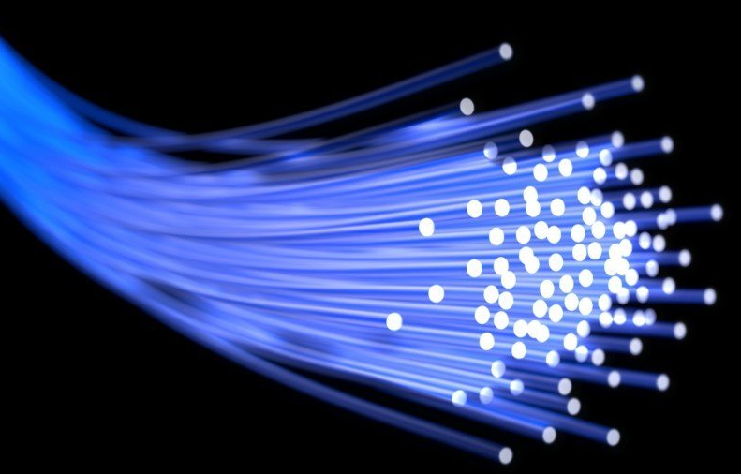
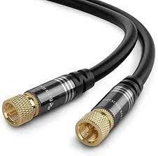
Basic Terminology
Computer Network: A computer network is composed of multiple computers connected using a telecommunication system.
Host: machines
PCs, workstation
Network components: routers
Interconnection maybe any medium capable of communicating information:
Cooper wire (Ethernet)
Lasers (Optical fiber)
Radio/Satellite link
Cable (coax)

Slide 3
A Client-Server Transaction
Most network applications are based on the client-server model:
A server process and one or more client processes
Server manages some resource
Server provides service by manipulating resource for clients
Server activated by request from client (vending machine analogy)
A server is a process – not a machine.
A server waits for a request from a client.
A client is a process that sends a request to an existing server and (usually) waits for a reply.

Slide 4
A Client-Server Transaction
1. Client sends request
Client
process
Server
process
Resource
4. Client
handles
response
3. Server sends response
2. Server
handles
request
Note: clients and servers are processes running on hosts
(can be the same or different hosts)
Example: A Web server manages a set of disk files that it retrieves and executes on behalf of clients.

Slide 5
Client-Server Examples
Web Server: Client request for a web page, server delivers
Mail Server: Email serves can be used for sending and receiving emails.
File Servers: They are the centralized locations for the files. Example: One drive, Google drive.

Slide 6
Hardware Organization of a Network Host
CPU chip
register file
ALU
system bus
memory bus
main
memory
MI
I/O
bridge
Expansion slots
I/O bus
USB
controller
graphics
adapter
disk
controller
network
adapter
mouse
keyboard
monitor
disk
network

Slide 7
Computer Networks
A network is a hierarchical system of boxes and wires organized by geographical proximity
SAN (System Area Network) spans cluster or machine room
Switched Ethernet,
LAN (Local Area Network) spans a building or campus
Ethernet is most prominent example
WAN (Wide Area Network) spans country or world
Typically, high-speed point-to-point phone lines
An internetwork (internet) is an interconnected set of networks
The Global IP Internet (uppercase “I”) is the most famous example of an internet (lowercase “i”)
Let’s see how an internet is built from the ground up

Slide 8
Lowest Level: Ethernet Segment
host
host
host
100 Mb/s
100 Mb/s
hub
port
Ethernet segment consists of a collection of hosts connected by wires (twisted pairs) to a hub
Spans room or floor in a building
Operation
Each Ethernet adapter has a unique 48-bit address (MAC address)
E.g., 00:16:ea:e3:54:e6
Hosts send bits to any other host in chunks called frames
Hub copies each bit from each port to every other port
Every host sees every bit
Note: Hubs are on their way out. Bridges (switches, routers) became cheap enough to replace them

Slide 9
Next Level: Bridged Ethernet Segment
A
B
host
host
host
host
host
X
hub
100 Mb/s
bridge
100 Mb/s
hub
1 Gb/s
host
host
hub
100 Mb/s
bridge
100 Mb/s
hub
Y
host
host
host
host
host
C
Spans building or campus
Bridges cleverly learn which hosts are reachable from which ports and then selectively copy frames from port to port

Slide 10
Conceptual View of LANs
For simplicity, hubs, bridges, and wires are often shown as a collection of hosts attached to a single wire:
host
host
...
host

Slide 11
Next Level: internets
Multiple incompatible LANs can be physically connected by specialized computers called routers
The connected networks are called an internet (lower case)
host
host
...
host
host
host
...
host
LAN 1
LAN 2
router
router
router
WAN
WAN
LAN 1 and LAN 2 might be completely different, totally incompatible
(e.g., Ethernet, Fiber Channel, 802.11*, T1-links, DSL, …)

Slide 12
Logical Structure of an internet
host
host
router
router
router
router
router
router
Ad hoc interconnection of networks
No particular topology
Vastly different router & link capacities
Send packets from source to destination by hopping through networks
Router forms bridge from one network to another
Different packets may take different routes

Slide 13
The Notion of an internet Protocol
How is it possible to send bits across incompatible LANs and WANs?
Solution: protocol software running on each host and router
Protocol is a set of rules that governs how hosts and routers should cooperate when they transfer data from network to network.
Smooths out the differences between the different networks

Slide 14


What’s a protocol?
a human protocol and a computer network protocol:
TCP connection
request
Hi
TCP connection
reply.
Hi
What’s the
time?
Get http://www.cs.mtsu.edu/~asainju/index.html
<file>
2:00
time
protocols define format, order of msgs sent and received among network entities, and actions taken on msg transmission, receipt
Notes:
An agreed upon convention for communication. both endpoints need to understand the protocol.
Protocols must be formally defined and unambiguous! We will study lots of existing protocols and perhaps develop a few of our own.

Slide 15
What Does an internet Protocol Do?
Provides a naming scheme
Different LAN technologies have different and incompatible ways of assigning address to host.
An internet protocol smooths these differences by defining a uniform format for host addresses
Each host (and router) is assigned at least one of these internet addresses that uniquely identifies it
Provides a delivery mechanism
An internet protocol defines a standard transfer unit (packet)
Packet consists of header and payload
Header: contains info such as packet size, source, and destination addresses
Payload: contains data bits sent from the source host

Slide 16
Transferring internet Data Via Encapsulation
LAN1
Host A
Host B
LAN2
client
server
(1)
data
(8)
data
protocol
software
protocol
software
internet packet
(2)
data
PH
FH1
(7)
data
PH
FH2
LAN1 frame
LAN1
adapter
LAN2
adapter
Router
(3)
data
PH
FH1
(6)
data
PH
FH2
LAN1
adapter
LAN2
adapter
LAN2 frame
(4)
data
PH
FH1
data
PH
FH2
(5)
PH: Internet packet header
FH: LAN frame header
protocol
software

Slide 17
Other Issues
We are glossing over a number of important questions:
What if different networks have different maximum frame sizes? (segmentation)
How do routers know where to forward frames?
How are routers informed when the network topology changes?
What if packets get lost?
These (and other) questions are addressed by the area of systems known as computer networking
CSCI 4300 – Data Communication and Network

Slide 18
Global IP Internet (upper case)
Most famous example of an internet
Based on the TCP/IP protocol family
IP (Internet Protocol) :
Provides basic naming scheme and unreliable delivery capability of packets (datagrams) from host-to-host
IP mechanism is unreliable in the sense that it makes no effort to recover if datagrams are lost or duplicated in the network.
UDP (Unreliable Datagram Protocol)
extends IP slightly to provide unreliable datagram delivery from process-to-process
TCP (Transmission Control Protocol)
Uses IP to provide reliable byte streams from process-to-process over connections
Accessed via a mix of Unix file I/O and functions from the sockets interface

Slide 19
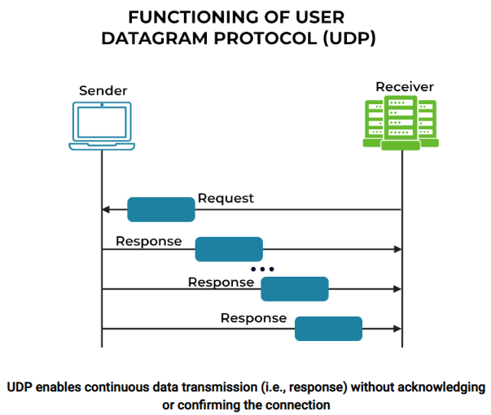
UDP
https://www.spiceworks.com/tech/networking/articles/tcp-vs-udp/

Slide 20
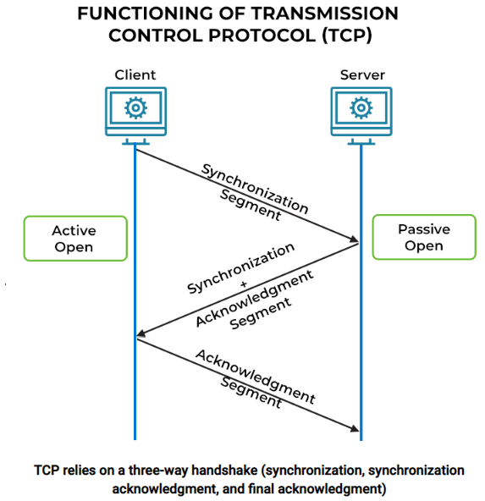
TCP
https://www.spiceworks.com/tech/networking/articles/tcp-vs-udp/

Slide 21
Hardware and Software Organization of an Internet Application
Internet client host
Internet server host
Client
User code
Server
Sockets interface
(system calls)
TCP/IP
Kernel code
TCP/IP
Hardware interface
(interrupts)
Network
adapter
Hardware
and firmware
Network
adapter
Global IP Internet
- Each Internet host runs software that implements the TCP/IP protocol.
Internet client and servers communicate using a mix of socket interface functions and Unix I/O functions.
The socket functions are typically implemented as system call.

Slide 22
A Programmer’s View of the Internet
1. Hosts are mapped to a set of 32-bit IP addresses
161.45.162.100
2. The set of IP addresses is mapped to a set of identifiers called Internet domain names
161.45.162.100 is mapped to www.cs.mtsu.edu
3. A process on one Internet host can communicate with a process on another Internet host over a connection

Slide 23
Aside: IPv4 and IPv6
The original Internet Protocol, with its 32-bit addresses, is known as Internet Protocol Version 4 (IPv4)
1996: Internet Engineering Task Force (IETF) introduced Internet Protocol Version 6 (IPv6) with 128-bit addresses
Intended as the successor to IPv4
As of 2022, vast majority of Internet traffic still carried by IPv4
Only around 38% of users access Google services using IPv6.
We will focus on IPv4, but will show you how to write networking code that is protocol-independent.

Slide 24
(1) IP Addresses
An IP address is an unsigned 32-bit integer.
Network program strores IP addresses in the IP address structure (shown below)
IP addresses are always stored in memory in network byte order (big-endian byte order)
Because Internet hosts can have different host byte order, TCP/IP defines a uniform network byte order (big-endian byte order) for any integer data item, such as IP address, that is carried across the network in a packet header.
Next slides shows a list of Unix functions for converting network and host byte order.
/* Internet address structure */
struct in_addr {
uint32_t s_addr; /* network byte order (big-endian) */
};

Slide 25
Unix Functions for byte order conversion
Useful network byte-order conversion functions
(“l” = 32 bits and “s” = 16 bits)
(n => network, h => host)
htonl: convert unit32_t from host to network byte order
htons: convert unit16_t from host to network byte order
ntohl: convert unit32_t from network to host byte order
ntohs: convert unit16_t from network to host byte order
#include <arpa/inet.h>
//Return value in network byte order
uint32_t htonl(uint32_t host);
uint16_t htons(uint16_t host);
//Return value in host byte order
uint32_t ntohl(uint32_t net);
uint16_t ntohs(uint16_t net);

Slide 26
Dotted Decimal Notation
By convention, each byte in a 32-bit IP address is represented by its decimal value and separated by a period
IP address: 0x8002C2F2 = 128.2.194.242
Use getaddrinfo and getnameinfo functions (described later) to convert between IP addresses and dotted decimal format.

Slide 27
Exercise
Convert the following 32-bit addresses into dotted decimal notation.
0xffffffff
0x0aff090c

Slide 28
(2) Internet Domain Names
unnamed root
.net
.edu
.gov
.com
First-level domain names
tsu
mtsu
utk
amazon
Second-level domain names
cs
ece
www
176.32.98.166
Third-level domain names
ranger
161.45.162.69
www
161.45.162.100

Slide 29
History
Before Domain Name System(DNS), all mappings were in hosts.txt
/etc/hosts on linux
C:\Windows\System32\drivers\etc\hosts on windows
Centralized, manual system
SRI was the first organization to assign website address such as www.sri.com with extensions such as “.com”, “.org”.
These addresses were assigned to network hosts by the Network Information Center (NIC), managed by SRI from 1970 until 1991.
Changes were submitted to SRI via email
Machines periodically FTP new copies of hosts.txt
Administrators could pick names at their discretion
Any name was allowed

Slide 30
Towards DNS
Eventually, the hosts.txt system fell apart
Not scalable, SRI couldn’t handle the load
Hard to enforce uniqueness of names
e.g MIT
Massachusetts Institute of Technology?
Melbourne Institute of Technology?
Many machines had inaccurate copies of hosts.txt
Thus, DNS was born

Slide 31
Domain Naming System (DNS)
The Internet maintains a mapping between IP addresses and domain names in a huge worldwide distributed database called DNS
No Centralization
Conceptually, programmers can view the DNS database as a collection of millions of host entries.
Each host entry defines the mapping between a set of domain names and IP addresses.
Hierarchical namespace
As opposed to original, flat namespace
E.g. .com -> google.com -> mail.google.com

Slide 32
Properties of DNS Mappings
Can explore properties of DNS mappings using nslookup
Output edited for brevity
Each host has a locally defined domain name localhost which always maps to the loopback address 127.0.0.1
Use hostname to determine real domain name of local host:
linux> nslookup localhost
Address: 127.0.0.1
linux> hostname
csci3240-00.cs.mtsu.edu

Slide 33
Properties of DNS Mappings (cont)
Simple case: one-to-one mapping between domain name and IP address:
Multiple domain names mapped to the same IP address:
linux> nslookup csci3240-00.cs.mtsu.edu
Address: 161.45.164.116
linux> nslookup www.mtsu.edu
Address: 10.14.0.116
linux> nslookup w1.mtsu.edu
Address: 10.14.0.116

Slide 34
Properties of DNS Mappings (cont)
Multiple domain names mapped to multiple IP addresses:
Some valid domain names don’t map to any IP address:
linux> nslookup www.twitter.com
Address: 199.16.156.6
Address: 199.16.156.70
Address: 199.16.156.102
Address: 199.16.156.230
linux> nslookup twitter.com
Address: 199.16.156.102
Address: 199.16.156.230
Address: 199.16.156.6
Address: 199.16.156.70
linux> nslookup csc.mtsu.edu
*** Can't find csc.mtsu.edu : No answer

Slide 35
(3) Internet Connections
Clients and servers communicate by sending streams of bytes over connections. Each connection is:
Point-to-point: connects a pair of processes.
Full-duplex: data can flow in both directions at the same time,
Reliable: stream of bytes sent by the source is eventually received by the destination in the same order it was sent.
A socket is an endpoint of a connection
Socket address is an IPaddress:port pair
A port is a 16-bit integer that identifies a process:
Ephemeral port: Assigned automatically by client kernel when client makes a connection request.
Well-known port: Associated with some service provided by a server (e.g., port 80 is associated with Web servers)

Slide 36
Well-known Ports and Service Names
Popular services have permanently assigned well-known ports and corresponding well-known service names:
echo server: 7/echo
ssh servers: 22/ssh
email server: 25/smtp
Web servers: 80/http
Mappings between well-known ports and service names is contained in the file /etc/services on each Linux machine.

Slide 37
Anatomy of a Connection
A connection is uniquely identified by the socket addresses of its endpoints (socket pair)
(cliaddr:cliport, servaddr:servport)
Client socket address
128.2.194.242:51213
Server socket address
208.216.181.15:80
Client
Server
(port 80)
Connection socket pair
(128.2.194.242:51213, 208.216.181.15:80)
Client host address
128.2.194.242
Server host address
208.216.181.15
51213 is an ephemeral port
allocated by the kernel
80 is a well-known port
associated with Web servers

Slide 38
Using Ports to Identify Services
Server host 128.2.194.242
Client host
Service request for
128.2.194.242:80
(i.e., the Web server)
Web server
(port 80)
Client
Kernel
Echo server
(port 7)
Service request for
128.2.194.242:7
(i.e., the echo server)
Web server
(port 80)
Client
Kernel
Echo server
(port 7)

Slide 39
Sockets Interface
Set of system-level functions are used in conjunction with Unix I/O to build network applications.
Available on all modern systems
Unix variants, Windows, OS X, IOS, Android, ARM

Slide 40
Sockets
What is a socket?
To the kernel, a socket is an endpoint of communication
To an application (program), a socket is a file descriptor that lets the application read/write from/to the network
Remember: All Unix I/O devices, including networks, are modeled as files
Clients and servers communicate with each other by reading from and writing to socket descriptors
The main distinction between regular file I/O and socket I/O is how the application “opens” the socket descriptors
Client
Server
clientfd
serverfd

Slide 41
Sockets Interface
2. Start client
1. Start server
Client
Server
getaddrinfo
getaddrinfo
socket
socket
open_listenfd
open_clientfd
bind
listen
Connection
request
connect
accept
3. Exchange
data
Client / Server
Session
rio_writen
rio_readlineb
Await connection
request from
next client
rio_readlineb
rio_writen
4. Disconnect client
EOF
5. Drop client
close
rio_readlineb
close

Slide 42
Sockets Address Structure
Internet socket addresses are stored in 16-byte structures having the type sockaddr_in
For Internet applications, sin_family field is AF_INET
The sin_port filed is a 16-bit port number
And, the sin_addr field contains a 32-bit IP address.
The IP address and port number are always stored in network byte order
struct sockaddr_in {
uint16_t sin_family; /* Protocol family (always AF_INET) */
uint16_t sin_port; /* Port num in network byte order */
struct in_addr sin_addr; /* IP addr in network byte order */
unsigned char sin_zero[8]; /* Pad to sizeof(struct sockaddr) */
};
Here, the _in suffix in sockaddr_in refers to internet, not input.

Slide 43
Socket Address Structures
Generic socket address:
The connect, bind, and accept functions requires a pointer to a protocol specific socket address structure.
The problem faced by the designer of the sockets interface was how to define these functions to accept any kind of socket address structure.
Necessary only because C did not have generic (void *) pointers when the sockets interface was designed.
The solution was to define sockets function to expect a pointer to a generic sockaddr structure and then require applications to cast any pointers to protocol-specific structures to this generic structure.
For casting convenience, we can use typedef:
typedef struct sockaddr SA;
struct sockaddr {
uint16_t sa_family; /* Protocol family */
char sa_data[14]; /* Address data. */
};
sa_family
Family Specific

Slide 44
Socket Address Structures
Internet-specific socket address:
Must cast (struct sockaddr_in *) to (struct sockaddr *) for functions that take socket address arguments.
struct sockaddr_in {
uint16_t sin_family; /* Protocol family (always AF_INET) */
uint16_t sin_port; /* Port num in network byte order */
struct in_addr sin_addr; /* IP addr in network byte order */
unsigned char sin_zero[8]; /* Pad to sizeof(struct sockaddr) */
};
struct sockaddr {
uint16_t sa_family; /* Protocol family */
char sa_data[14]; /* Address data. */
};
sin_port
sin_addr
AF_INET
0
0
0
0
0
0
0
0
sa_family
sin_family
Family Specific

Slide 45





Socket Programming: An Analogy with a Phone call
Phone number A
Phone number B
A
B

Slide 46
Sockets Interface
Client
Server
getaddrinfo
getaddrinfo
socket
socket
open_listenfd
open_clientfd
bind
listen
Connection
request
connect
accept
Client / Server
Session
rio_writen
rio_readlineb
Await connection
request from
next client
rio_readlineb
rio_writen
close
EOF
rio_readlineb
close

Slide 47
Sockets Interface: socket
TCP Socket can be compared to a phone
We need a device to call someone or accept their phone calls, right?
To perform network I/O, the first thing a process must do is, call the socket function to create a specific type of socket by specifying the type of communication protocol desired, protocol family, etc.

Slide 48
Sockets Interface: socket
Clients and servers use the socket function to create a socket descriptor:
Example:
#include <sys/socket.h>
int socket(int domain, int type, int protocol)
int clientfd = Socket(AF_INET, SOCK_STREAM, 0);
Indicates that we are using 32-bit IPV4 addresses
Indicates that the socket will be the end point of a connection
Protocol specific! Best practice is to use getaddrinfo to generate the parameters automatically, so that code is protocol independent.

Slide 49
Sockets Interface
Client
Server
getaddrinfo
getaddrinfo
socket
socket
open_listenfd
open_clientfd
bind
listen
Connection
request
connect
accept
Client / Server
Session
rio_writen
rio_readlineb
Await connection
request from
next client
rio_readlineb
rio_writen
close
EOF
rio_readlineb
close

Slide 50
Sockets Interface: bind
It is like registering a phone number to the phone (to connect to other phones).
Sockets do not have a complete address in the beginning to start transferring the data, so we bind a Socket to a port.
Analogy: Phones do not have a phone number at the beginning to make phone calls, so we register a phone number.
The process of allocating a port number to a socket is called ‘binding’.

Slide 51
Sockets Interface: bind
A server uses bind to ask the kernel to associate the server’s socket address with a socket descriptor:
The process can read bytes that arrive on the connection whose endpoint is addr by reading from descriptor sockfd.
Similarly, writes to sockfd are transferred along connection whose endpoint is addr.
Best practice is to use getaddrinfo to supply the arguments addr and addrlen.
#include <sys/socket.h>
int bind(int sockfd, SA *addr, socklen_t addrlen);

Slide 52
Sockets Interface
Client
Server
getaddrinfo
getaddrinfo
socket
socket
open_listenfd
open_clientfd
bind
listen
Connection
request
connect
accept
Client / Server
Session
send
receive
Await connection
request from
next client
receive
send
close
EOF
receive
close

Slide 53
Sockets Interface: listen
Clients are active entities that initiate connection requests.
Servers are passive entities that wait for connection requests from clients.
By default, the kernel assumes that a descriptor created by the socket function corresponds to an active socket that will be live on the client end of a connection.
A server calls the listen function to tell the kernel that a descriptor will be used by a server rather than a client:
int listen(int sockfd, int backlog);

Slide 54
Sockets Interface: listen
The listen function converts sockfd from an active socket to a listening socket that can accept connection requests from clients.
The backlog is a hint about the number of outstanding connection requests that the kernel should queue up before starting to refuse requests.
We will typically set it to a large value, such as 1024.
int listen(int sockfd, int backlog);

Slide 55
Sockets Interface
Client
Server
getaddrinfo
getaddrinfo
socket
socket
open_listenfd
open_clientfd
bind
listen
Connection
request
connect
accept
Client / Server
Session
send
receive
Await connection
request from
next client
receive
send
close
EOF
receive
close

Slide 56
Sockets Interface: accept
Accept a connection request
Transition of the connection request from listen() method to an actual Socket
Servers wait for connection requests from clients by calling accept function:
The accept function waits for connection request to arrive on the connection bound to listening descriptor listenfd, then fills in client’s socket address in addr and size of the socket address in addrlen.
Finally, it returns a connected descriptor that can be used to communicate with the client via Unix I/O routines.
int accept(int listenfd, SA *addr, int *addrlen);

Slide 57
Make the logical steps from the 4 previous parts
Sequence
Step 1. Creating the socket (socket function call)
Step 2. Bind the socket to a port (bind function call)
Step 3. Listen for incoming connection requests & identify ones (listen function call)
Step 4. Accept the identified connection request and open the socket (accept function call)

Slide 58
Sockets Interface
Client
Server
getaddrinfo
getaddrinfo
socket
socket
open_listenfd
open_clientfd
bind
listen
Connection
request
connect
accept
Client / Server
Session
send
receive
Await connection
request from
next client
receive
send
close
EOF
receive
close

Slide 59
Sockets Interface: connect
A client establishes a connection with a server by calling connect:
Attempts to establish a connection with server at socket address addr
If successful, then clientfd is now ready for reading and writing.
Resulting connection is characterized by socket pair
x is client address
y is ephemeral port that uniquely identifies client process on client host
int connect(int clientfd, SA *addr, socklen_t addrlen);
(x:y, addr.sin_addr:addr.sin_port)
Best practice is to use getaddrinfo to supply the arguments addr and addrlen.

Slide 60
accept Illustrated
listenfd(3)
Client
Server
1. Server blocks in accept, waiting for connection request on listening descriptor listenfd
clientfd
Connection
request
listenfd(3)
Client
Server
2. Client makes connection request by calling and blocking in connect
clientfd
listenfd(3)
3. Server returns connfd from accept. Client returns from connect. Connection is now established between clientfd and connfd
Client
Server
clientfd
connfd(4)

Slide 61
Connected vs. Listening Descriptors
Listening descriptor
End point for client connection requests
Created once and exists for lifetime of the server
Connected descriptor
End point of the connection between client and server
A new descriptor is created each time the server accepts a connection request from a client
Exists only as long as it takes to service client
Why the distinction?
Allows for concurrent servers that can communicate over many client connections simultaneously
E.g., Each time we receive a new request, we fork a child to handle the request

Slide 62
Sockets Interface
Client
Server
getaddrinfo
getaddrinfo
socket
socket
open_listenfd
open_clientfd
bind
listen
Connection
request
connect
accept
Client / Server
Session
send
receive
Await connection
request from
next client
receive
send
close
EOF
receive
close

Slide 63
Host and Service Conversion: getaddrinfo
getaddrinfo is the modern way to convert string representations of hostnames, host addresses, ports, and service names to socket address structures.
Replaces obsolete gethostbyname and getservbyname funcs.
Advantages:
Reentrant (can be safely used by threaded programs).
Allows us to write portable protocol-independent code
Works with both IPv4 and IPv6
Disadvantages
Somewhat complex
Fortunately, a small number of usage patterns suffice in most cases.

Slide 64
Host and Service Conversion: getaddrinfo
int getaddrinfo(const char *host, /* Hostname or address */
const char *service, /* Port or service name */
const struct addrinfo *hints,/* Input parameters */
struct addrinfo **result); /* Output linked list */
void freeaddrinfo(struct addrinfo *result); /* Free linked list */
const char *gai_strerror(int errcode); /* Return error msg */
Given host and service, getaddrinfo returns result that points to a linked list of addrinfo structs, each of which points to a corresponding socket address struct, and which contains arguments for the sockets interface functions.
Helper functions:
freeadderinfo frees the entire linked list.
gai_strerror converts error code to an error message.

Slide 65
Linked List Returned by getaddrinfo
addrinfo structs
result
Socket address structs
ai_canonname
ai_addr
ai_next
NULL
ai_addr
ai_next
NULL
ai_addr
NULL
Clients: walk this list, trying each socket address in turn, until the calls to socket and connect succeed.
Servers: walk the list until calls to socket and bind succeed.

Slide 66
addrinfo Struct
struct addrinfo {
int ai_flags; /* Hints argument flags */
int ai_family; /* First arg to socket function */
int ai_socktype; /* Second arg to socket function */
int ai_protocol; /* Third arg to socket function */
char *ai_canonname; /* Canonical host name */
size_t ai_addrlen; /* Size of ai_addr struct */
struct sockaddr *ai_addr; /* Ptr to socket address structure */
struct addrinfo *ai_next; /* Ptr to next item in linked list */
};
Each addrinfo struct returned by getaddrinfo contains arguments that can be passed directly to socket function.
Also points to a socket address struct that can be passed directly to connect and bind functions.

Slide 67
Host and Service Conversion: getnameinfo
getnameinfo is the inverse of getaddrinfo, converting a socket address to the corresponding host and service.
Replaces obsolete gethostbyaddr and getservbyport funcs.
Reentrant and protocol independent.
int getnameinfo(const SA *sa, socklen_t salen, /* In: socket addr */
char *host, size_t hostlen, /* Out: host */
char *serv, size_t servlen, /* Out: service */
int flags); /* optional flags */

Slide 68
Conversion Example
hostinfo.c
#include "csapp.h"
int main(int argc, char **argv)
{
struct addrinfo *p, *listp, hints;
char buf[MAXLINE];
int rc, flags;
/* Get a list of addrinfo records */
memset(&hints, 0, sizeof(struct addrinfo));
hints.ai_family = AF_INET; /* IPv4 only */
hints.ai_socktype = SOCK_STREAM; /* Connections only */
if ((rc = getaddrinfo(argv[1], NULL, &hints, &listp)) != 0) {
fprintf(stderr, "getaddrinfo error: %s\n", gai_strerror(rc));
exit(1);
}
hostinfo.c

Slide 69
Conversion Example (cont)
/* Walk the list and display each IP address */
flags = NI_NUMERICHOST; /* Display address instead of name */
for (p = listp; p; p = p->ai_next) {
Getnameinfo(p->ai_addr, p->ai_addrlen,
buf, MAXLINE, NULL, 0, flags);
printf("%s\n", buf);
}
/* Clean up */
Freeaddrinfo(listp);
exit(0);
}
hostinfo.c

Slide 70
Running hostinfo
csci3240-00> ./hostinfo localhost
127.0.0.1
csci3240-00 > ./hostinfo www.cs.mtsu.edu
161.145.162.100
csci3240-00 > ./hostinfo google.com
142.250.10.147
142.250.10.104
142.250.10.106
142.250.10.99
142.250.10.103
142.250.10.105

